Slide 1
$100 Million ML startup
How to build the future

Slide 2
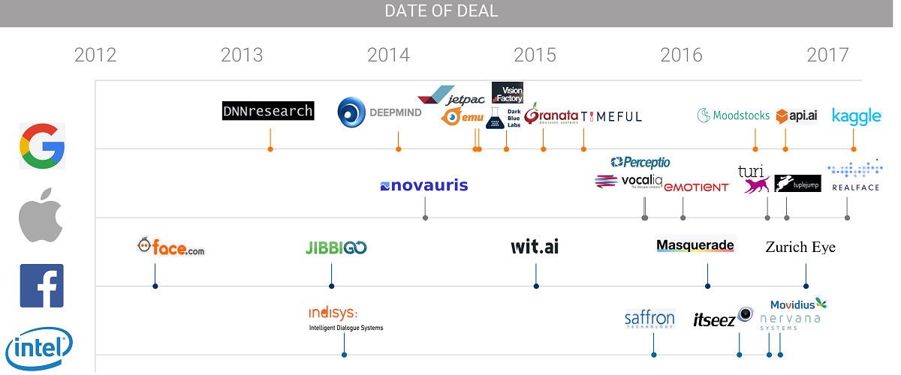
Recent Acquisitions

Slide 3
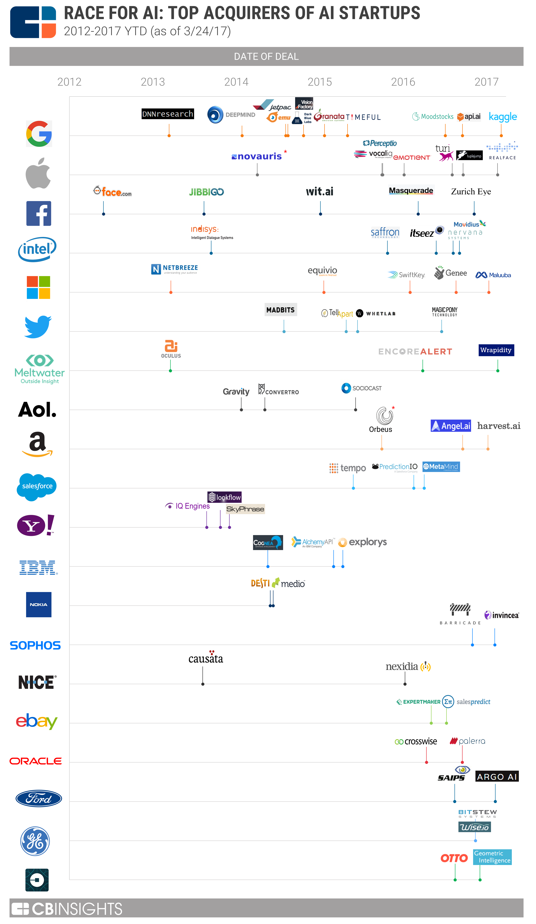
The Full Picture
The race to acquire AI companies includes more participants than ever before
200 AI companies acquired since 2012
30 companies acquired in Q1 2017 alone

Slide 4


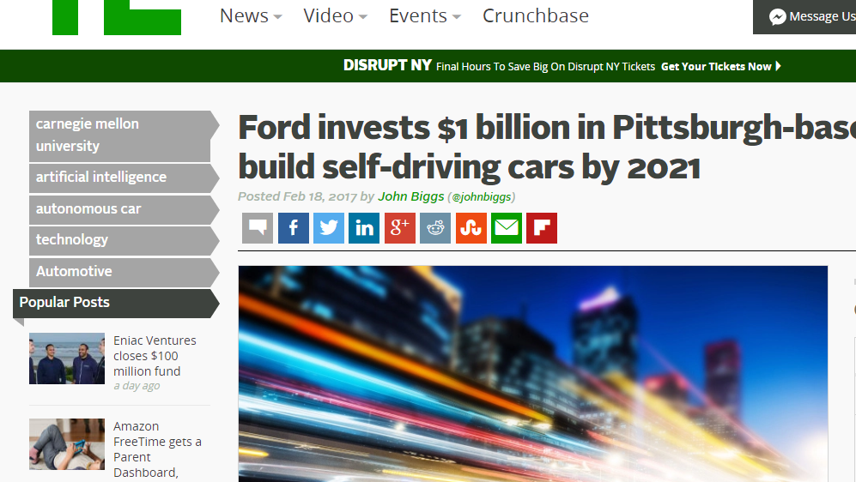



Ford’s $1B acquisition of Argo.ai

Slide 5
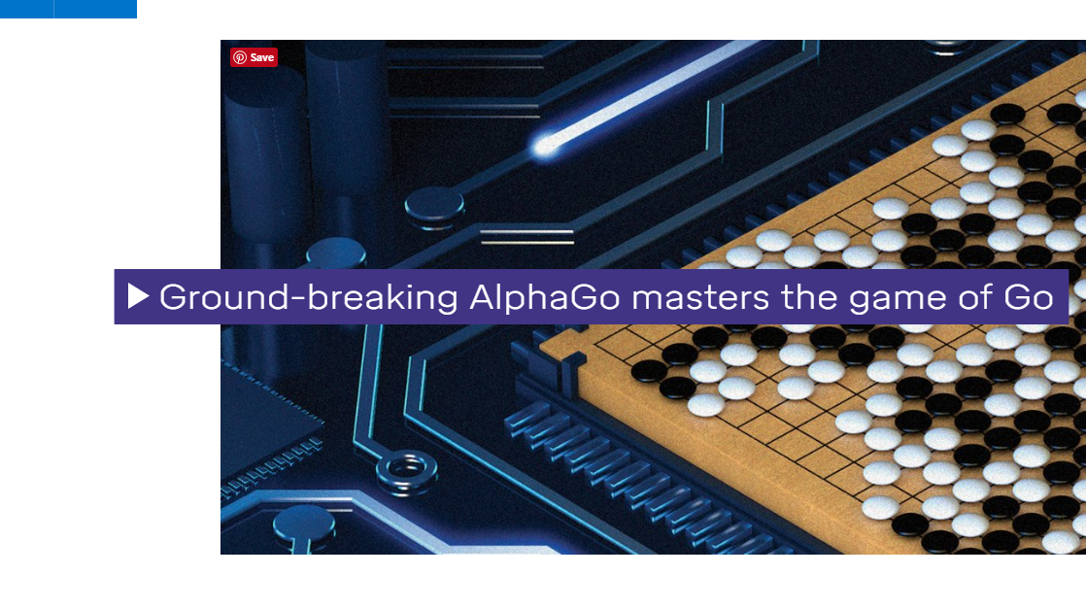
Google’s $600+M acquisition of DeepMind

Slide 6
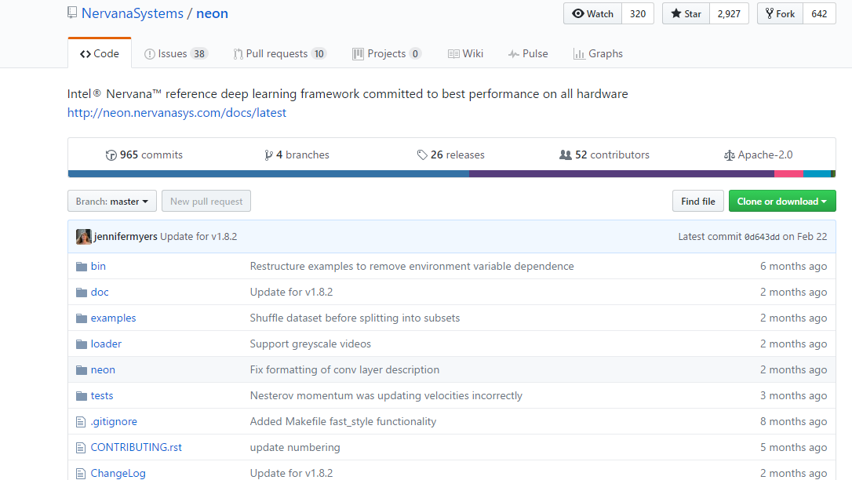
Intel’s $400M acquisition of Nervana

Slide 7
The only things you should know
> Machine Learning
> Applying it to a field that makes it useful

Slide 8
What kind of business can you build?

Slide 9
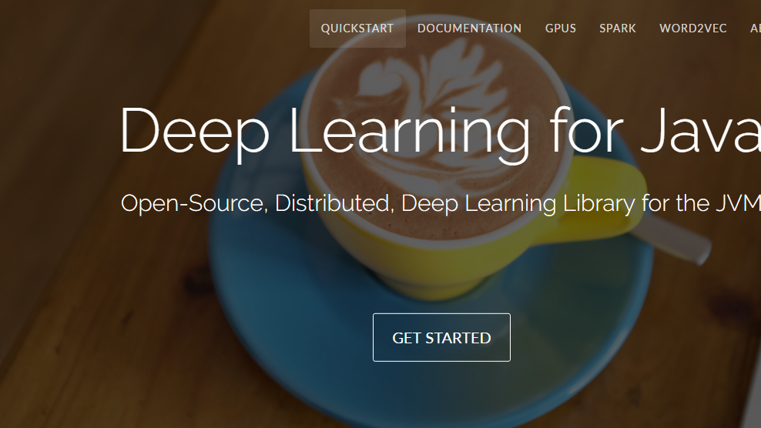
Platforms

Slide 10
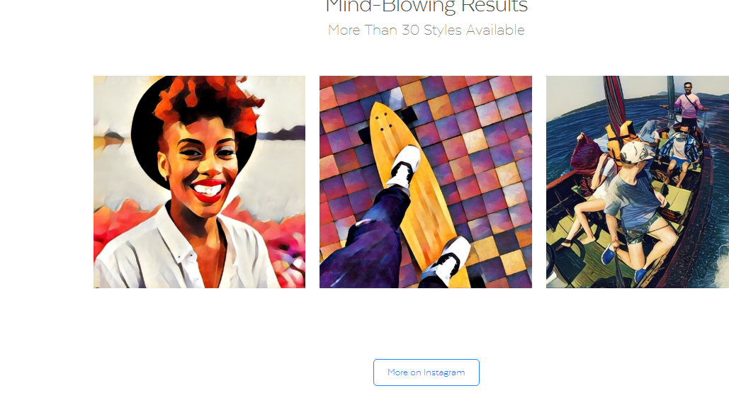
Products

Slide 11
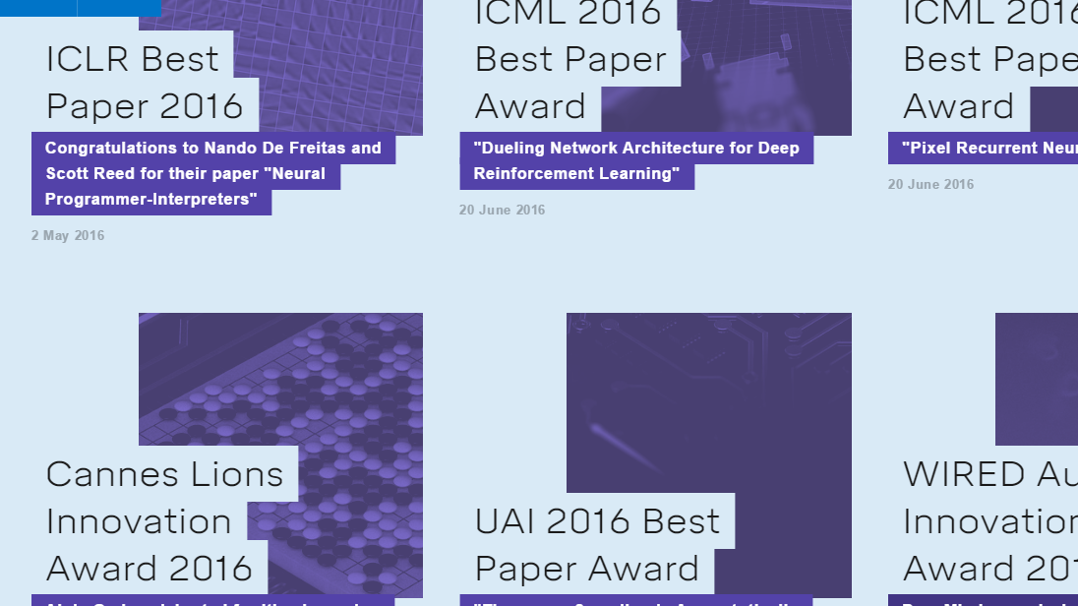
Team

Slide 12
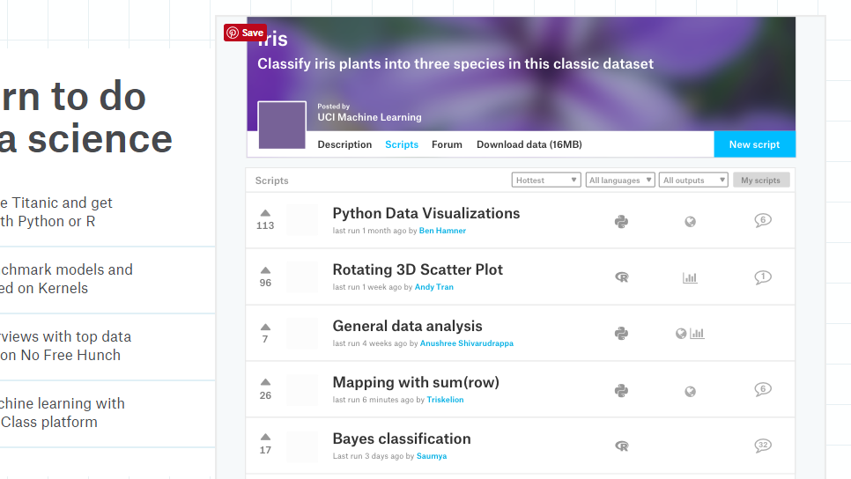
Data

Slide 13
Solving a problem creatively

Slide 14
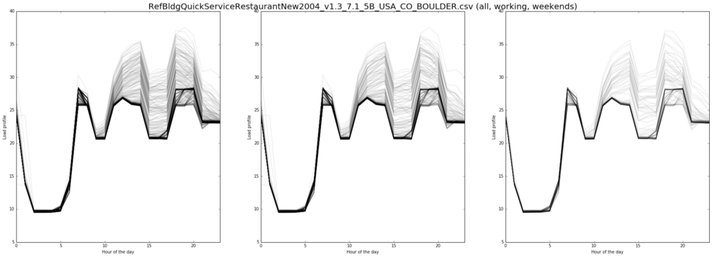
Energy Consumption (restaurant)

Slide 15
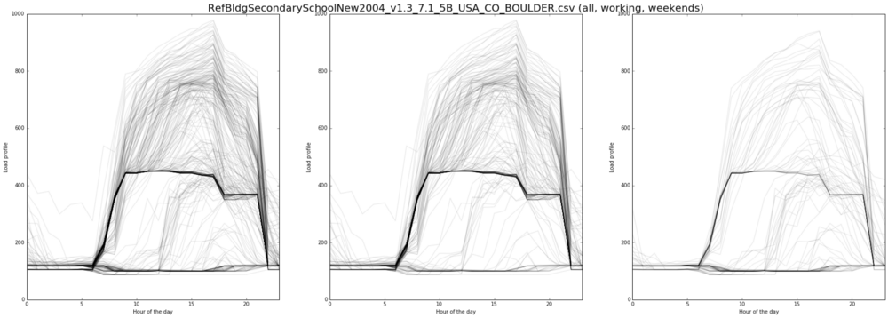
Energy Consumption (school)

Slide 16
Applying Machine Learning

Slide 17
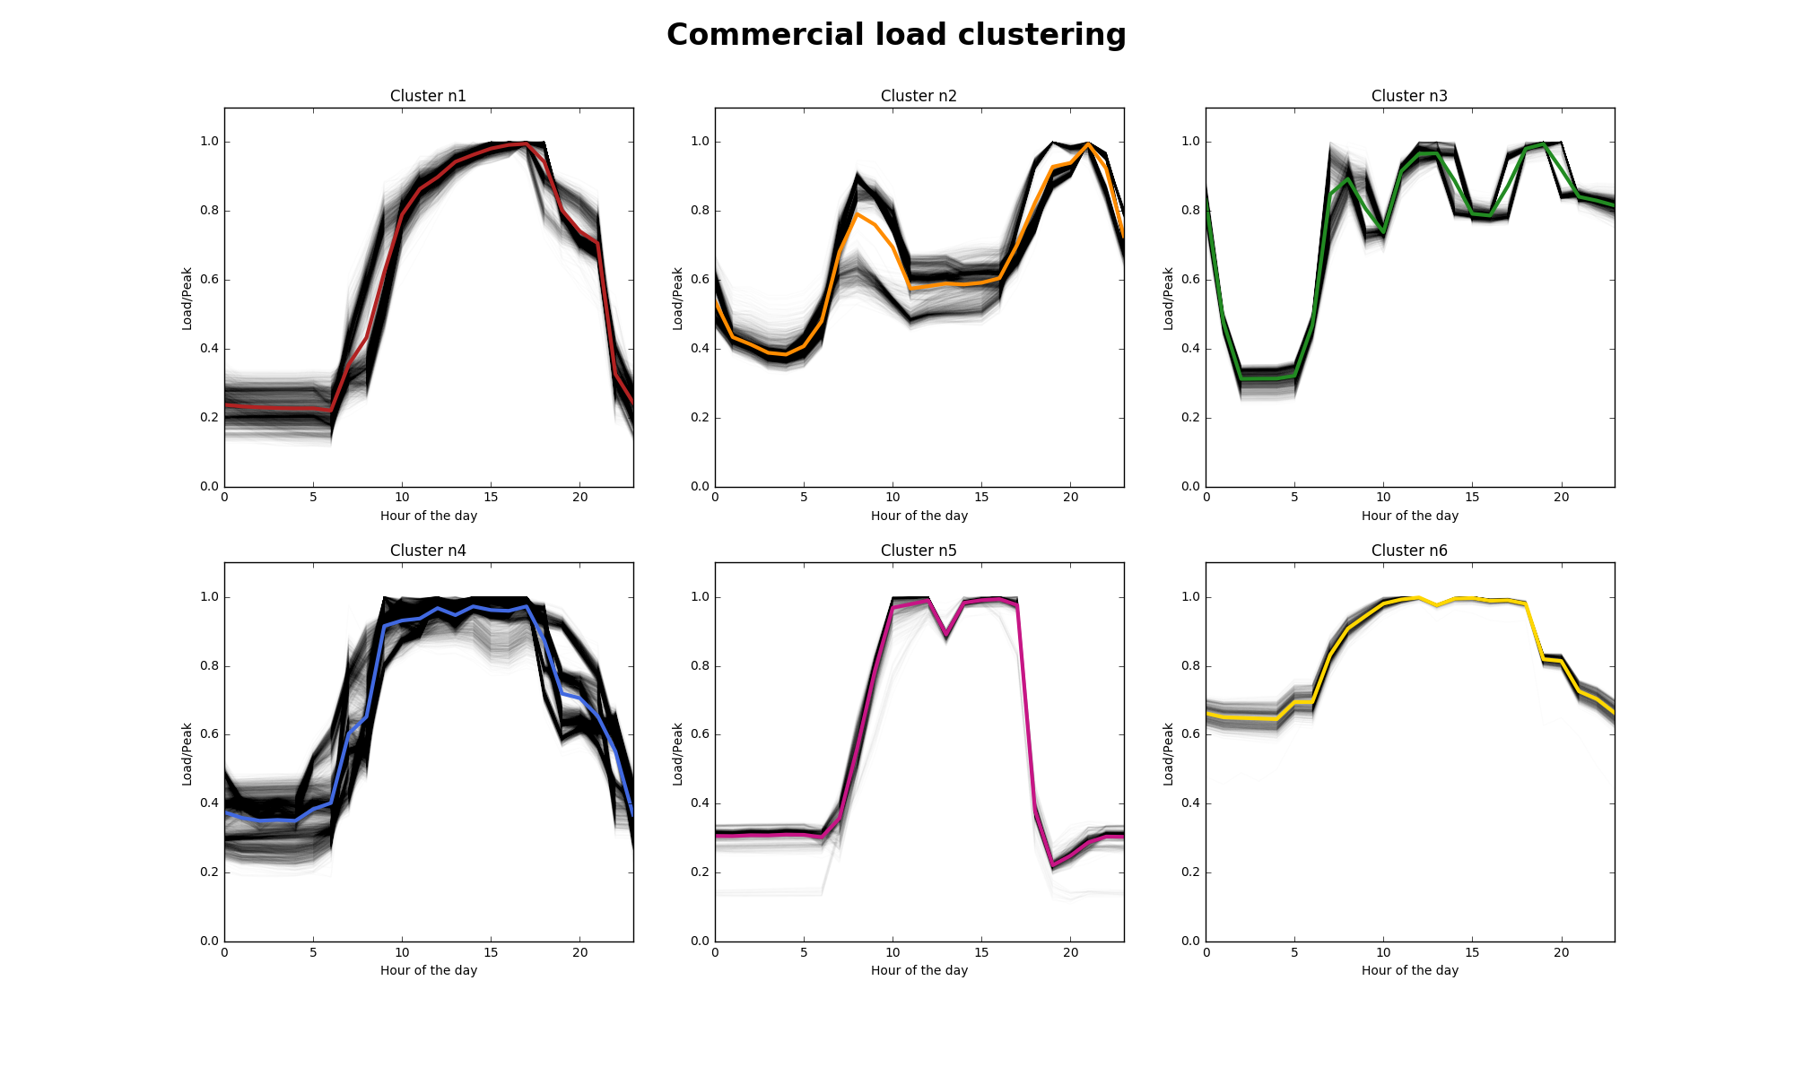

Slide 18
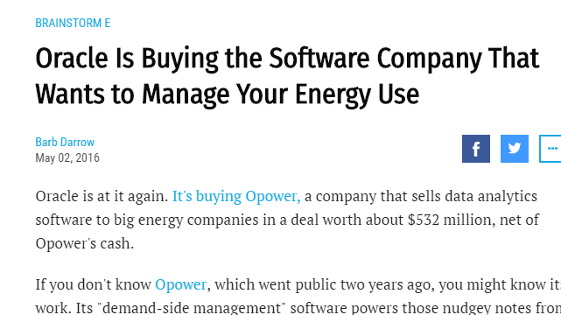
Oracle’s $500+M acquisition of Opower

Slide 19
Know the ecosystem

Slide 20
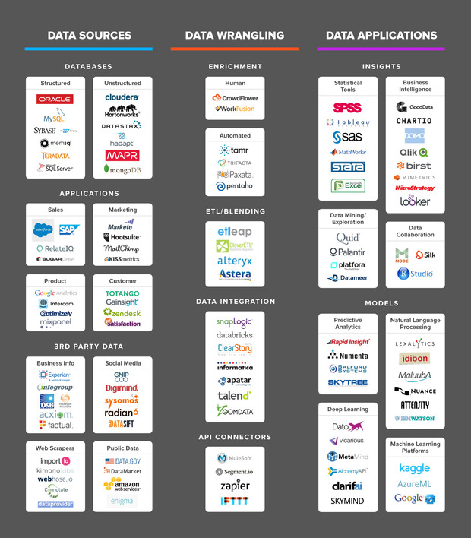

Slide 23
The first 10,000 pitches are the hardest

Slide 24
That, was session 1!
Hands-On session after lunch break

